Slide 1
Quick Parenting Assessment (QPA): Why and How to Use It Seth Scholer, MD, MPH Professor of Pediatrics Division of General Pediatrics September 2023

Slide 2
Healthy Discipline 100% Our goal, albeit aspirational, is for 100% of parents to know about healthy discipline strategies

Slide 3
Pediatrics, 2015

Slide 4
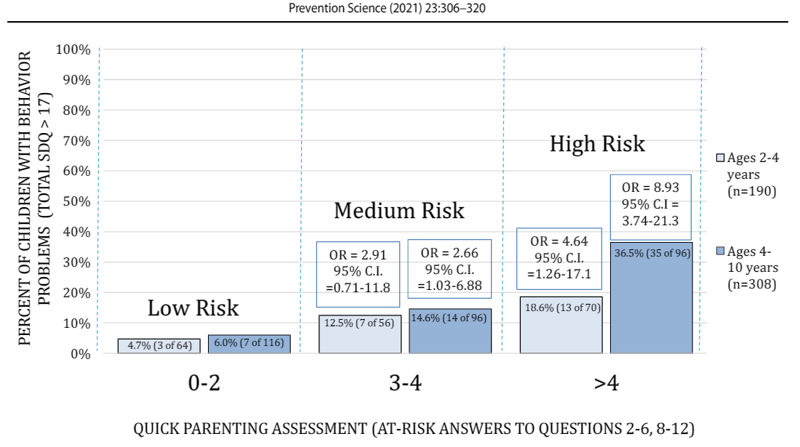
The Development, Preliminary Validation, and Clinical Application of the QPA
Despite the acknowledgment that parenting is a strong social determinant of health, parenting is not routinely assessed and addressed during the pediatric primary care visit.
There are validated parenting assessment tools, but most are too long for clinical use.
This led to the development, preliminary validation, and clinical application of the QPA.*
Children, ages 4-10, with QPAs > 4 were nine times more likely to have behavior problems compared with children with QPAs < 2.
In 2021, we started to routinely administer the QPA in our clinic at the 15 month, 30 month, 5 year, and 8 year well child visits.
*Prevention Science. 2021

Slide 5
QPA Perspectives and Process Measures
Perspectives and Process Measures | Health Care Provider | Parent
Should health care providers ask questions about how children are disciplined QPA completed but not reviewed QPA completed and reviewed |  | 80% 92%
Helped with communication about parenting | 75% | 53%
Helped give right level of support | 67% | 89%
Added value to the well child visit | 68% | 78%
Parent plans to make changes on how they discipline at home Low QPA (0-2) Elevated QPA (>2) |  | 40% 32% 83%
Time needed to review the QPA Low QPA (0-2) Elevated QPA (>2) | < 1 min: 72% <2 min: 69%

Slide 6
Potential Benefits of the QPA
Prevent disease and improve population health*
Some unhealthy discipline strategies can be adverse childhood experiences (ACEs)
Lung disease, heart disease, obesity, alcoholism, illicit drug use, violence, child abuse, depression, suicide, unemployment, and homelessness
Parents
Support parents in pediatric primary care
Improve parent-child relationships
Pediatric health care providers
Increase providers’ objectivity to offer the right level of intervention, realizing that some parents need little, or no, education whereas other parents need lengthy interventions
Time saver: Most QPAs can be reviewed in less than 1-2 minutes
Reimbursement: CPT code (96160), Patient focused health risk assessment
*Prevention Science. 2021

Slide 7
Quick Parenting Assessment (QPA) Item Development
Child abuse Unhealthy parenting Healthy parenting
Yelling
Threatening
Spanking
Humiliating language
Redirecting
Spending more time with child and setting expectations
No QPA items diagnose child abuse
5. Other punitive discipline
Ideally, health care providers need to know about the parenting behaviors of all caregivers.

Slide 8
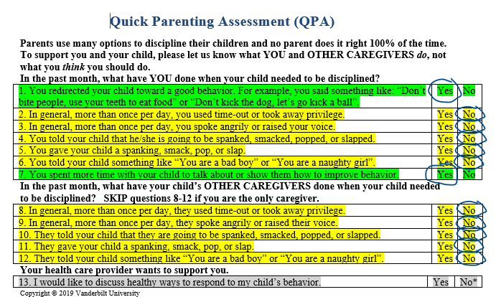
Design features
Brief
Supportive
Based upon science and/or consensus
Never diagnoses child abuse
Captures other caregivers’ behaviors
1. Redirecting
2. Other punitive discipline
3. Speaking angrily/yelling
4. Threatening language
5. Physical punishment
6. Humiliating language
7. Setting expectations
8. Other punitive discipline
9. Speaking angrily/yelling
10. Threatening language
11. Physical punishment
12. Humiliating language
13. Parent interest

Slide 9
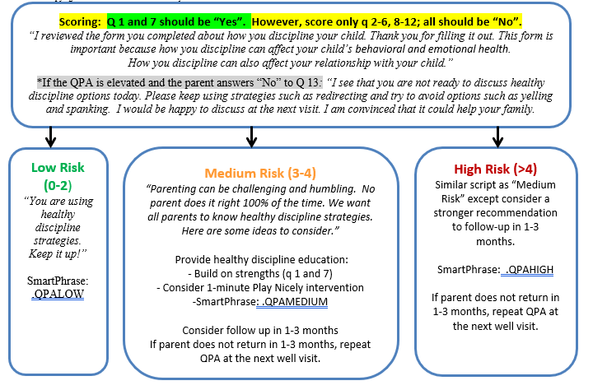
80%
15%
5%

Slide 10
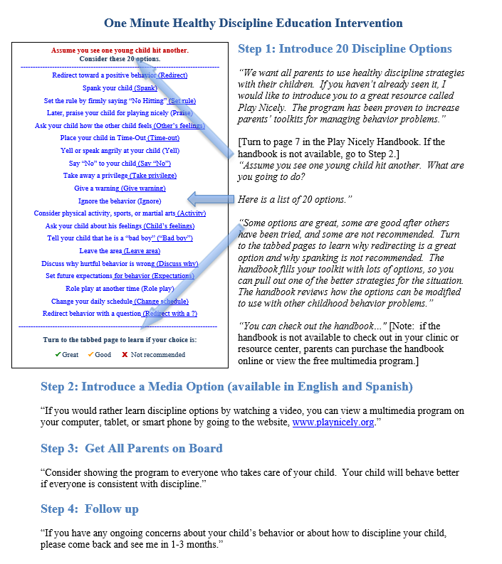
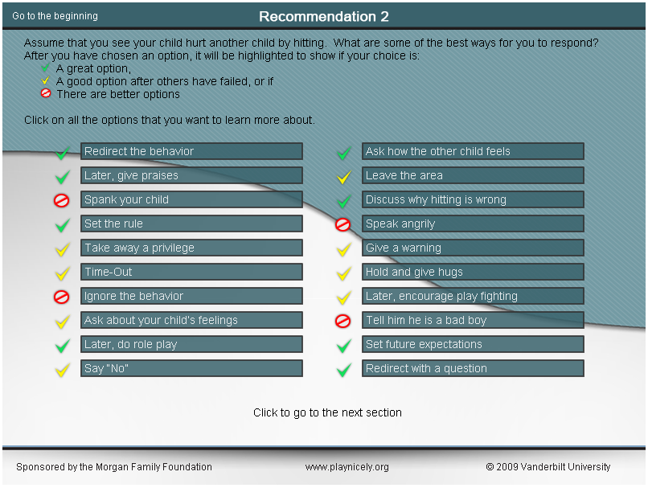

Slide 11
Discharge Instructions: Smart Phrases

Slide 12
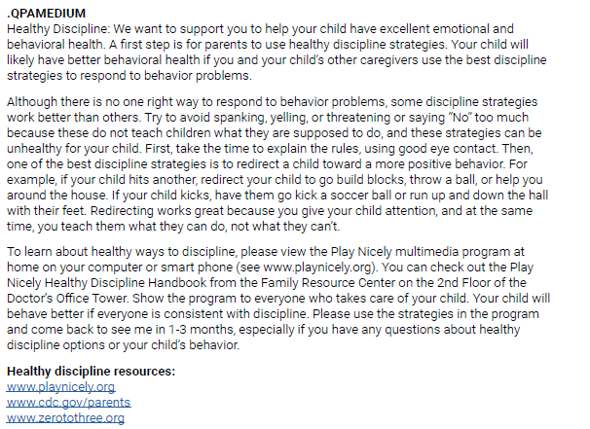
Discharge Instructions: Smart Phrases

Slide 13
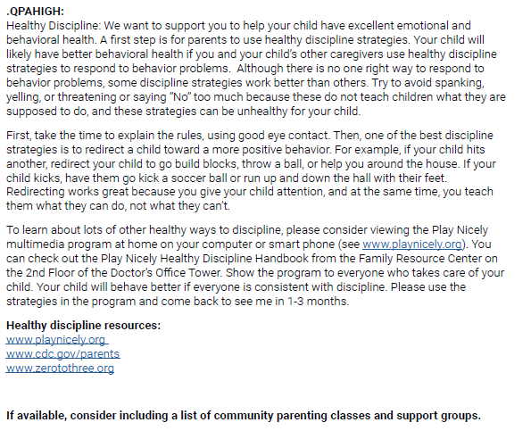
Discharge Instructions: Smart Phrases

Slide 14
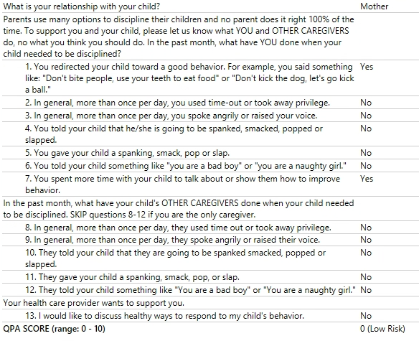

Slide 15
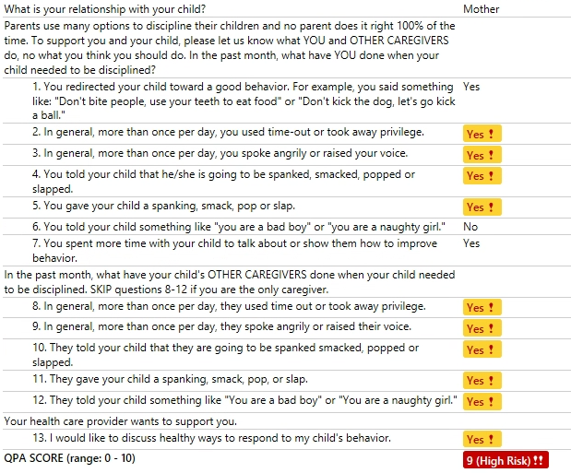
Assessment/Plan
1. Well child check, 8 years
-BMI in 97th percentile
-QPA high risk
-Covid vaccine declined
2. Behavior concern
-Given high risk QPA and parental concern regarding ADHD and ODD, will refer to Mental health co-op to initiate counseling
-Will initiate ADHD evaluation today
-Has IEP in place
-Encourage school based therapies
Additional Plan, if any:
RTC in 3 months or sooner if concerns arise.

Slide 16
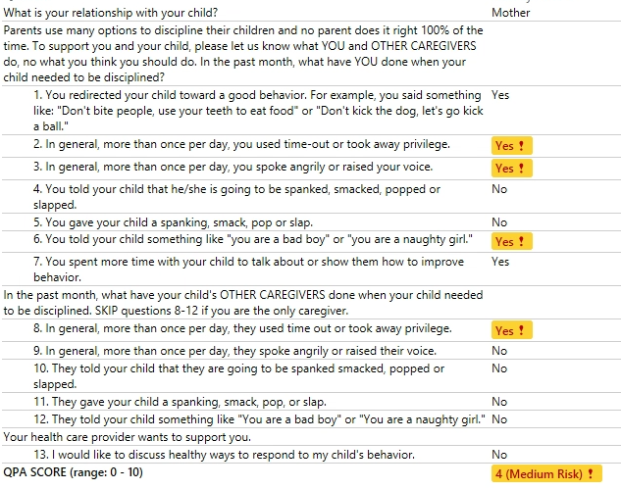

Slide 17
QPA Scripts for Success
Explain why: “Thank you for completing this form. We want all parents to know about healthy discipline strategies. This because we know that how parents discipline their children can affect children’s behavioral, emotional, and physical health. Also, how you discipline can affect your relationship with your child.”
Inject humility: “Parenting can be humbling, and no parent does it right 100% of the time.”
Build strengths and assets: “When I review your form, I see that you are using some of the best strategies to discipline your child – redirecting (q 1), spending more time with your child and setting expectations (q 7).”
Be flexible and patient: For example, if the parent is using unhealthy discipline but responded that they did not want to discuss discipline, you might say, “We have learned a lot over the years about many healthy discipline strategies such as redirecting. From the form you filled out, it looks like you are not ready today, but, in the future, I would be happy to discuss some of these great discipline options with you. I am convinced it could help your family.”

Slide 18
Limitation
Social desirability bias
The QPA serves as both an assessment and educational tool

Slide 19
Potential Benefits of the QPA
Prevent disease and improve population health*
Some unhealthy discipline strategies can be adverse childhood experiences (ACEs)
Lung disease, heart disease, obesity, alcoholism, illicit drug use, violence, child abuse, depression, suicide, unemployment, and homelessness
Parents
Support parents in pediatric primary care
Improve parent-child relationships
Pediatric health care providers
Increase providers’ objectivity to offer the right level of intervention, realizing that some parents need little, or no, education whereas other parents need lengthy interventions
Time saver: Most QPAs can be reviewed in less than 1-2 minutes
Reimbursement: CPT code (96160), Patient focused health risk assessment
*Prevention Science. 2021

Slide 20
QPA: Other Benefits and Uses
Assessment and treatment of children with behavior problems such as ADHD, aggression, and oppositional behavior
Low QPA:
Encourage ongoing use of healthy, consistent discipline
Consider assessment for ADHD or underlying conduct disorder
Elevated QPA
Emphasize healthy discipline as an important first step in the treatment plan

Slide 21
QPA: Other Benefits and Uses
Bullying prevention
Unhealthy parenting, especially coercive behaviors, such as spanking, yelling, and threatening language can contribute to children’s bullying behaviors.
Validated parenting assessment tools might allow pediatricians to address unhealthy parenting and intervene before it contributes to bullying behavior.
Unhealthy parenting
Bullying behavior

Slide 22
The potential for a parenting assessment integrated into pediatric practice and linked to effective, brief interventions
Child abuse Unhealthy parenting Healthy parenting
Yelling
Threatening
Spanking
Humiliating language
Redirecting
Spending more time with child and setting expectations
No QPA items diagnose child abuse
5. Other punitive discipline
Support and reassurance
Rates of child abuse and associated diseases
Proportion of parents who shift from using
unhealthy discipline strategies to healthy ones

Slide 23
Healthy Discipline 100% Our goal, albeit aspirational, is for 100% of parents to know about healthy discipline strategies

Slide 24
Acknowledgments
Vanderbilt University and Vanderbilt University Medical Center (VUMC)
VUMC Department of Pediatrics
VUMC Division of General Pediatrics
Vanderbilt Interpreter Services
Vanderbilt Heard University Libraries
Vanderbilt Center for Technology Transfer and Commercialization
Funding: Tennessee Department of Health
Tennessee Department of Children’s Services, Building Strong Brains Tennessee Programs, Projects and Activities, 2017-2019

Slide 25
References and Contact Information
Validation manuscript:
Sausen K.A., Randolph J.W., Casciato A.N., Dietrich M.S., Scholer S.J. The Development, Preliminary Validation, and Clinical Application of the Quick Parenting Assessment. Prev Sci. 2021 Nov 15. [Full text]
QPA written instructions: www.quickparentingassessment.org
Contact for inquiries, research, and collaboration: Seth.Scholer@VUMC.org
Thank you for viewing!

